Slide 1
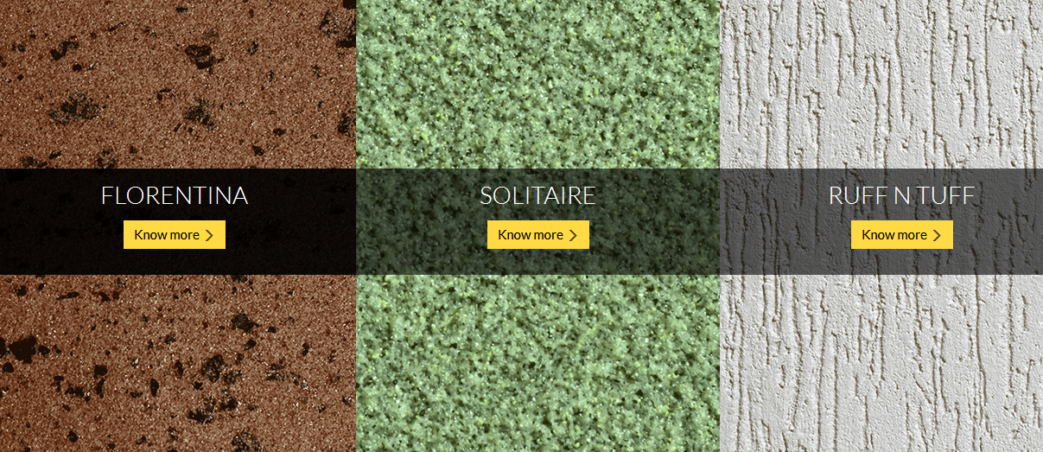


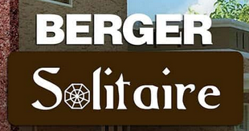
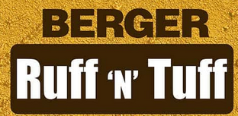
BERGER TEXTURES

Slide 2
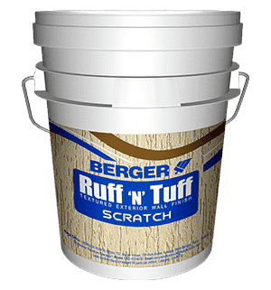
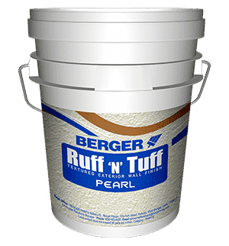
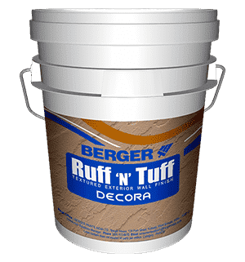
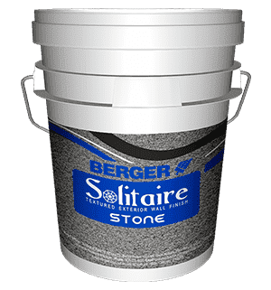
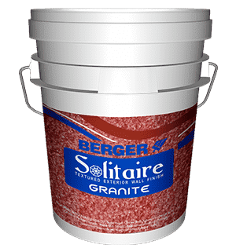
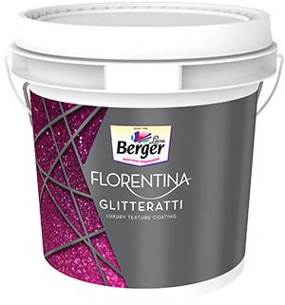
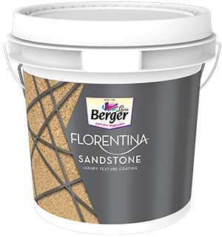
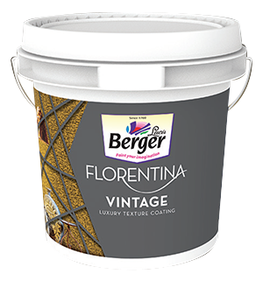
BERGER TEXTURES
ECONOMY
LUXURY
SUPER LUXURY

Slide 3
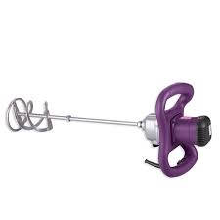
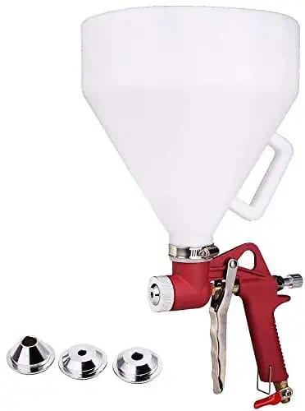
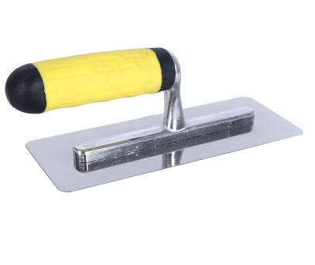
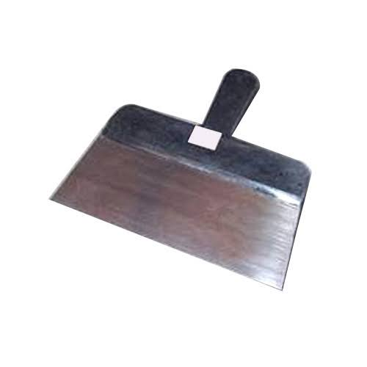
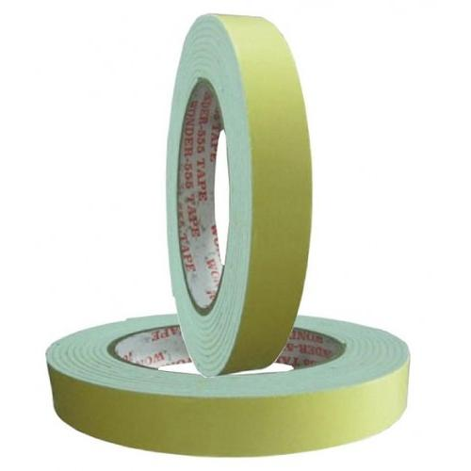
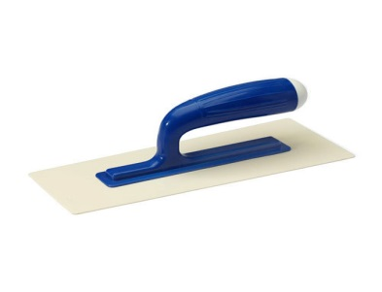
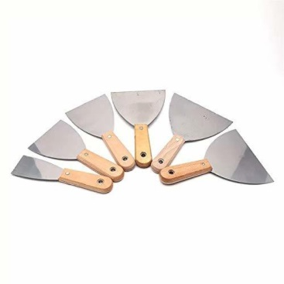
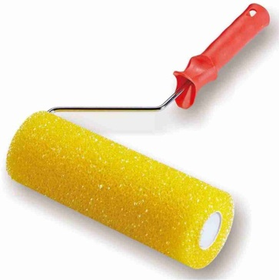
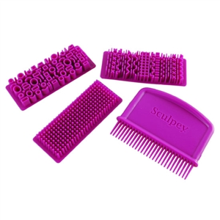
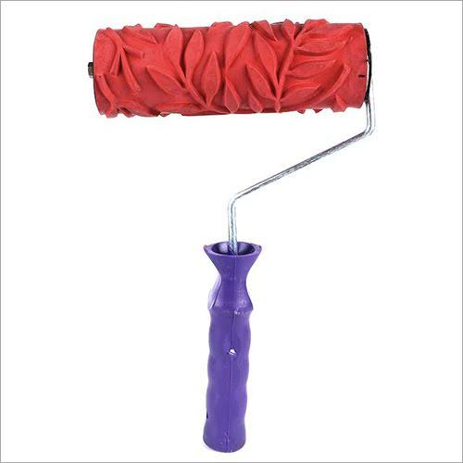
TOOLS REQUIRED
PUTTY MIXER
HOPPER GUN
STEEL TROWEL
PUTTY BLADE
PLASTIC TROWEL
FOAM TAPE
SCRAPERS
DESIGNS ROLLERS & TOOLS

Slide 4




BERGER
RUFF N TUFF
SCRATCH
Popular & preferred grooved finish texture
Formulated with modified acrylic emulsion & reinforced with quartz – to stand with humidity, rain & variable climates.
Tough groove finish
Can be applied on fresh plastered or weather beaten surfaces For Exterior

Slide 5
Solvent Dilution ratio Coverage Drying Time Finish/Shades
BERGER
RUFF N TUFF
SCRATCH
Potable Water
Upto 3% (v/v) water for better workability
1.6 – 4.5 Sqft / kg / coat (depend on variants)
Surface dry - 30 minutes
Hard Dry: 12- 16 hours
Matt / Off white
Pack size/ Variants Application tools
Shelf life / Potlife
30 KG drum/ bag; Variants – Fine, Regular, Standard, High Build
Trowel
12 months in drum packing; 6 month in bag / 2 -3 hrs of thinned material

Slide 6
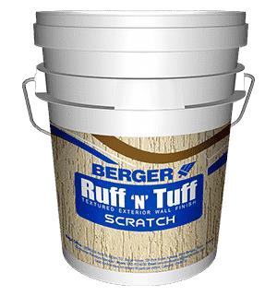

BERGER
RUFF N TUFF
SCRATCH
Recommended Variants
Fine ( 0.8 – 1 mm): | recommended for very smooth surfaces
Regular (1.2 – 1.5 mm): | recommended for smooth surface
Standard (2 – 2.5 mm): | recommended for medium rough surface
High build (3mm +): | recommended for rough surface
Direction of use
Primer application – apply 1 coat of WC exterior primer/Seal-o-prime and allow it for 4-6hrs
Texture application – Apply 1 coat of Ruff ‘n’ Tuff- Scratch with trowel and allow it to dry for 16 – 18 hrs Top coat – Apply 2 coats of Berger Weathercoat (Longlife, Antidust, Glow) as finishing coat.

Slide 7




RUFF N TUFF
SCRATCH
PRODUCT | DILUTION | COVERAGE | NO OFCOATS | TOOLS | MATERIAL COST
Scratch Fine | 3-5% of fresh water | 3 -3.5 Sq.ft./Kg/Coat | 1 | Trowel | 15/Sq.ft
Scratch Regular | 3-5% of fresh water | 2.5 Sq.ft./Kg/Coat | 1 | Trowel | 19/Sq.ft
Scratch Standard | 3-5% of fresh water | 2.5 Sq.ft./Kg/Coat | 1 | Trowel | 19/Sq.ft
Scratch Hi-Build | 3-5% of fresh water | 2-2.5 Sq.ft./Kg/Coat | 1 | Trowel | 20/Sq.ft

Slide 8
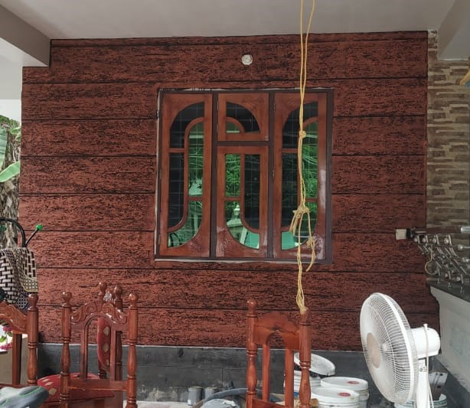
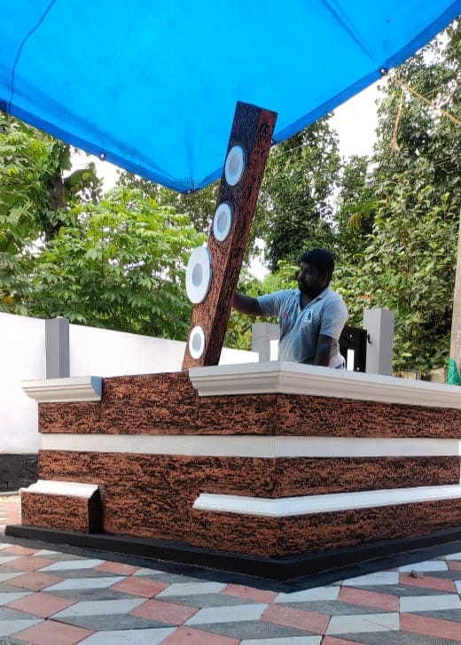
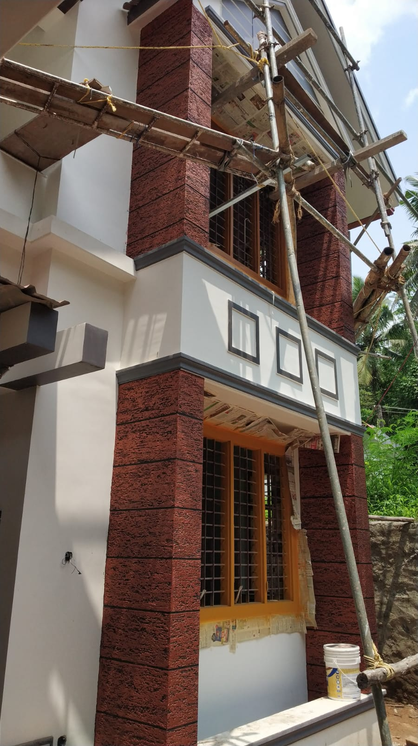
RUFF N TUFF SCRATCH SITE AT KOZHENCHERRY & CHAKKUVALLY DONE BY MR. LALU

Slide 9
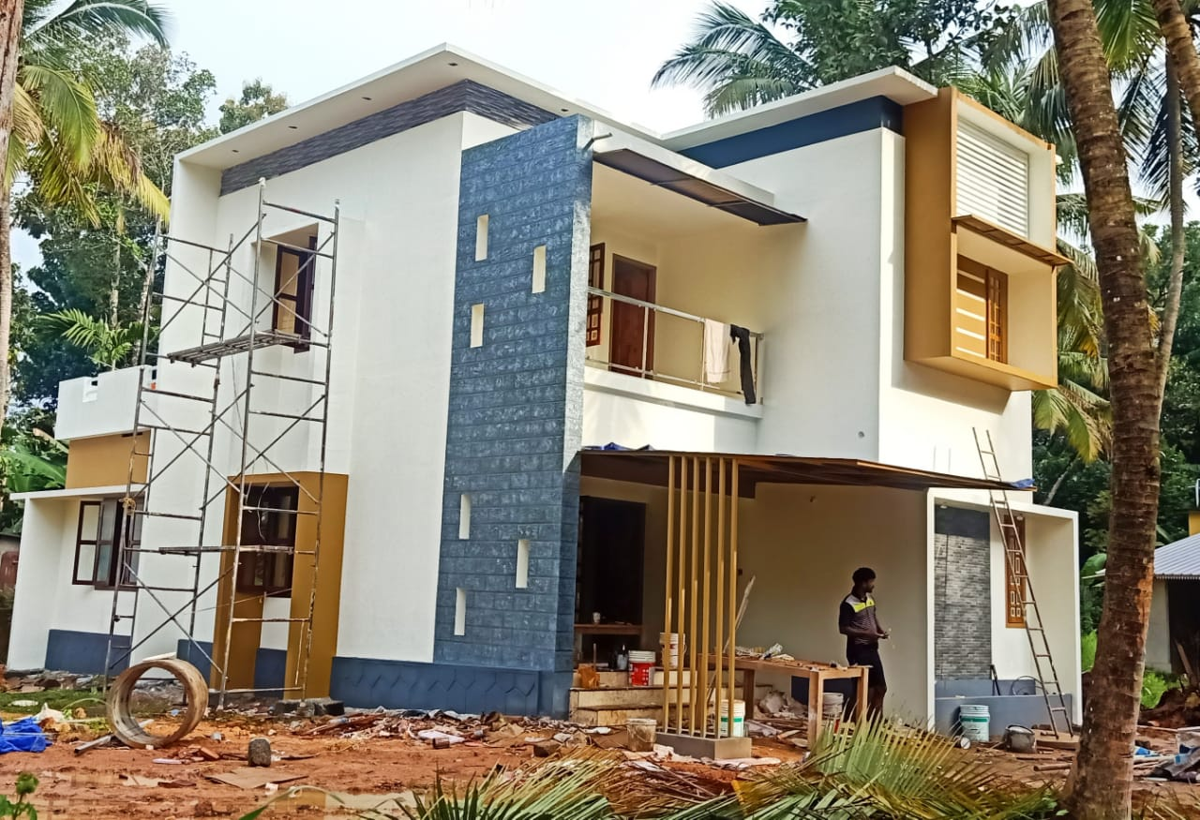
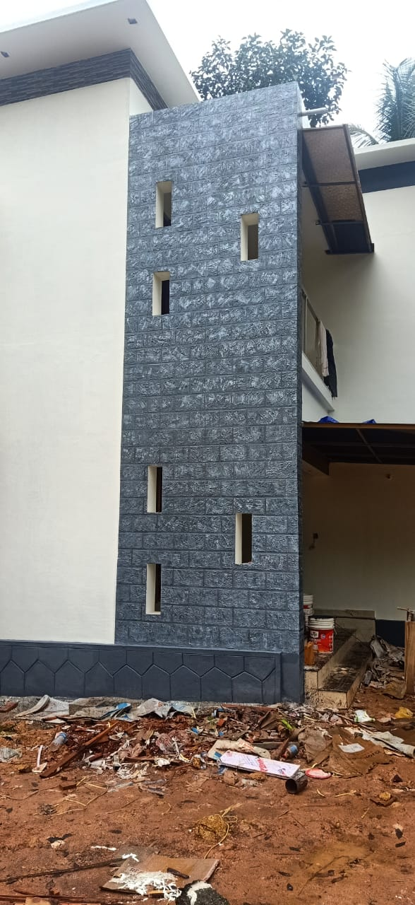
RUFF N TUFF SCRATCH SITE AT THIRUVALLA DONE BY MR. SHIVAKUMAR

Slide 10

BERGER
RUFF N TUFF
PEARL
Elegant BUBBLE & spattered finish texture
All weather durability Excellent durability, long lasting
Can be applied in Interior & Exterior

Slide 11
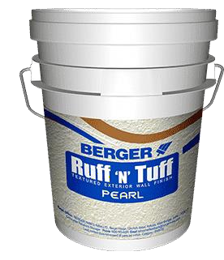
BERGER
RUFF N TUFF
PEARL
Solvent Dilution ratio Coverage Drying Time Finish/Shades Pack size
Application tools
Shelf life / Potlife
Potable Water
3 ~ 5 % (v/v) water for better workability
5 ~ 8 Sqft / kg / coat
Surface dry – 1 hr
Hard Dry: 16 ~ 18 hours
Matt / White
30 KG drum
Hopper spray gun
12 months in drum packing / 2 -3 hrs of thinned material

Slide 12
BERGER
RUFF N TUFF
PEARL
Direction of use
Primer application – apply 1 coat of WC exterior primer/Seal-o-prime and allow it for 4-6hrs
Texture application – Apply 1 coat of Ruff ‘n’ Tuff- Pearl with hopper spray gun and allow it to dry for 16 – 18 hrs
Top coat – Apply 2 coats of Berger Weathercoat (Longlife, Antidust, Glow) as finishing coat.

Slide 13
RUFF N TUFF
PEARL
PRODUCT | DILUTION | COVERAGE | NO OFCOATS | TOOLS | MATERIAL COST
PEARL | 3-5% of fresh water | 7-10Sq.ft./Kg/Coat | 1 | HOPPER GUN | 7/Sq.ft

Slide 14
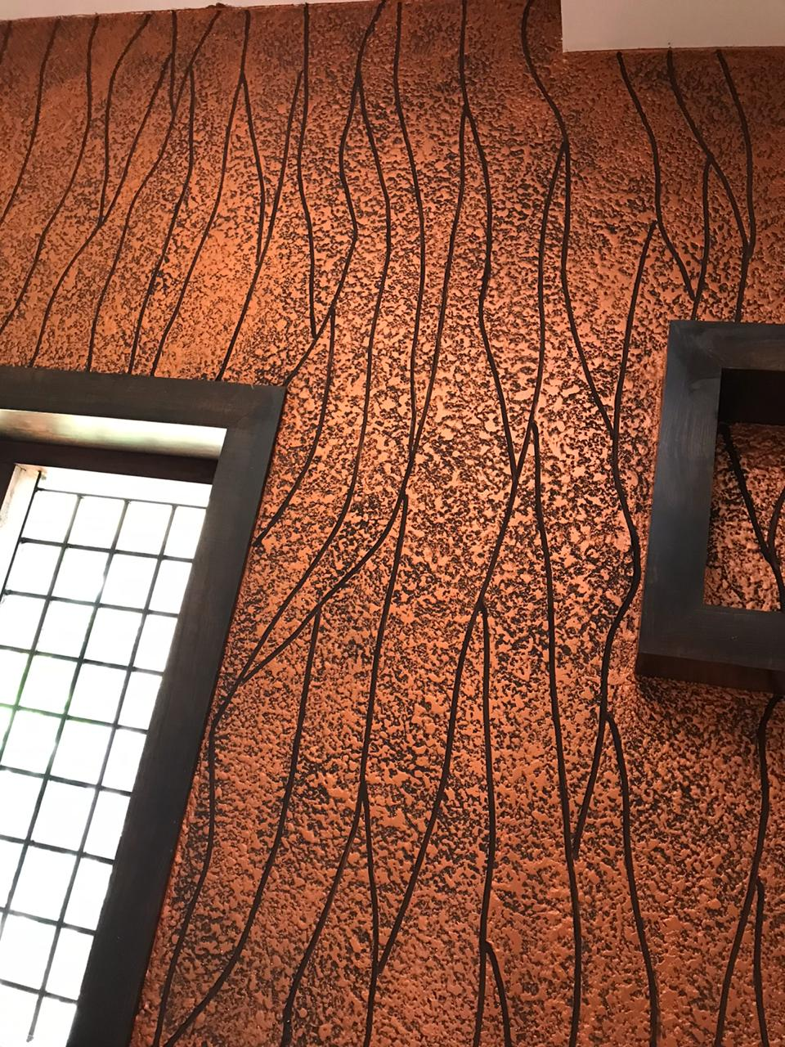
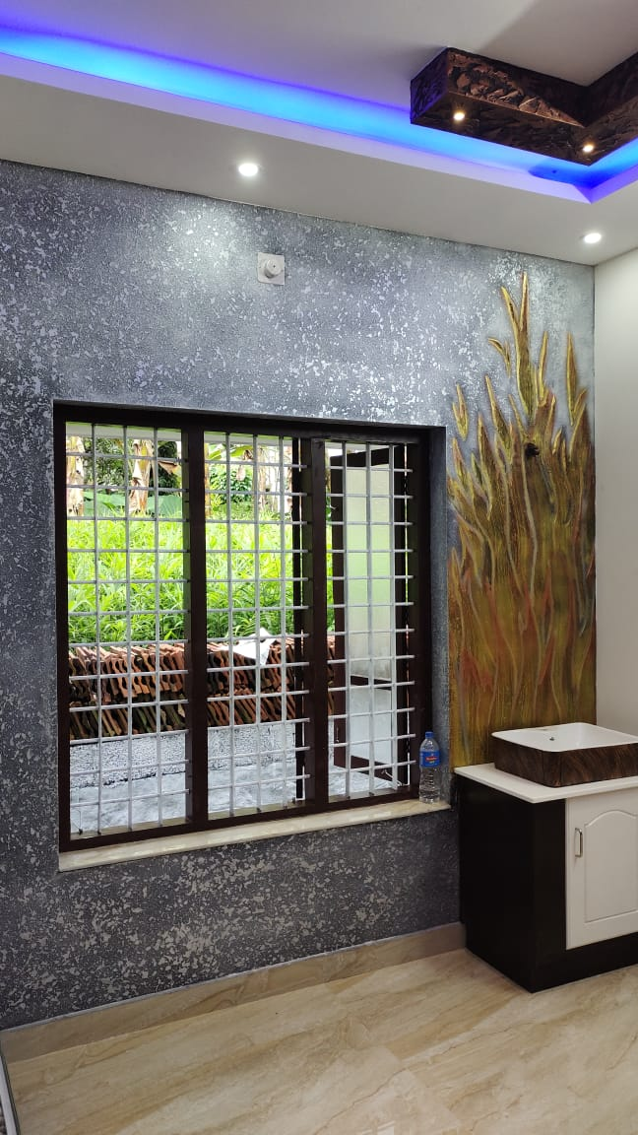
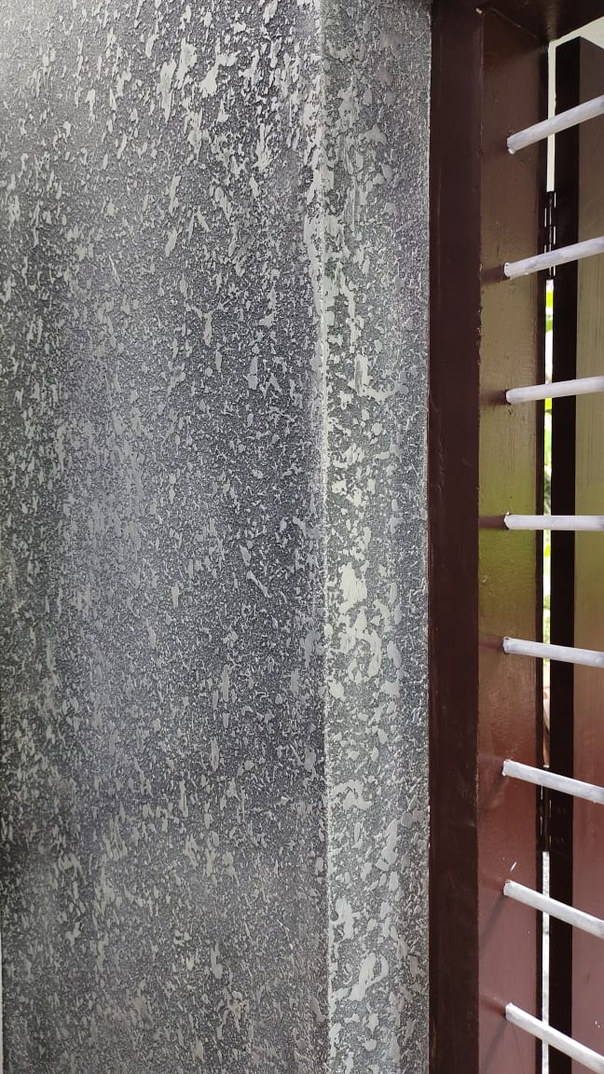
RUFF N TUFF PEARL SITE AT ADOOR & CHADAYAMANGALAM DONE BY MR. MANU (HI-TECH)

Slide 15

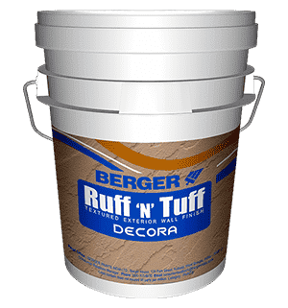



BERGER
RUFF N TUFF
DECORA
1.DECORA – DHOLPUR STONE
2.DECORA – ROLLERCOAT
3.DECORA – ROLLERCAST
4.Decora- Plaino Super cast
4.DECORA – PLAINO SUPERCAST
5.DECORA – PLAINO DESERT
6.DECORA – STUCCO ACESS

Slide 16


BERGER
RUFF N TUFF
DECORA- DHOLPUR STONE
Assorted decorative stone finish texture
Special synthetic copolymer emulsion reinforced with silica aggregates having excellent bonding properties
Excellent durability, long lasting
Covers surface imperfections & roughness Green Pro Certified

Slide 17
BERGER
RUFF N TUFF
DECORA- DHOLPUR STONE
Solvent Dilution ratio Coverage Drying Time Finish/Shades Pack size
Application tools
Shelf life / Potlife
Potable Water
3 ~ 5 % (v/v) water for better workability
2 ~ 2.5Sqft / kg / coat ( approx. 2 – 2.5 mm thickness)
Surface dry – 1 hr
Hard Dry: 16 ~ 18 hours
Matt / Off -White
30 KG drum
Scrapper, Steel trowel, Design tools etc
12 months in drum packing / 2 -3 hrs of thinned material

Slide 18
RUFF N TUFF
DECORA DHOLPUR STONE
PRODUCT | DILUTION | COVERAGE | TOOLS | MATERIAL COST
DHOLPUR STONE | 3-5% of fresh water | 2-2.5 Sq.ft./Kg/Coat | SCRAPPERS, DESIGNS TOOLS etc | 18/Sq.ft

Slide 19
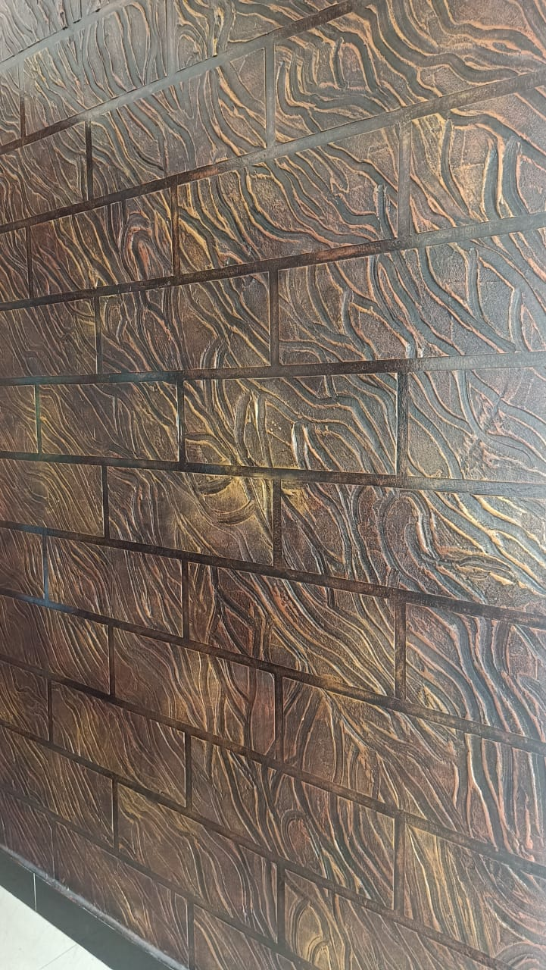
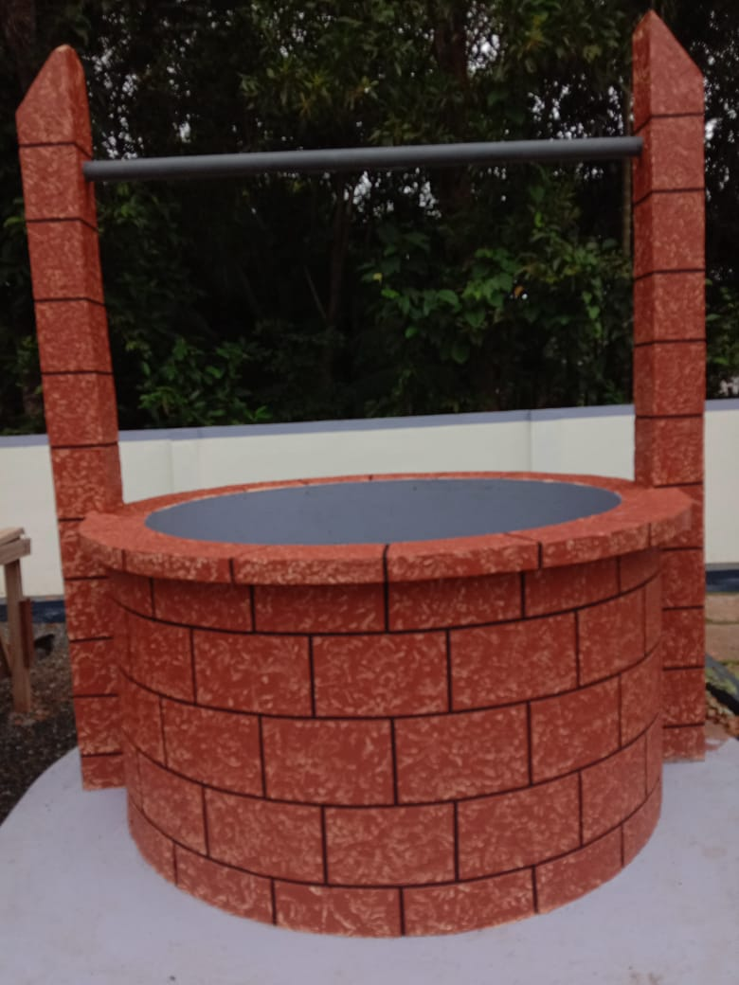
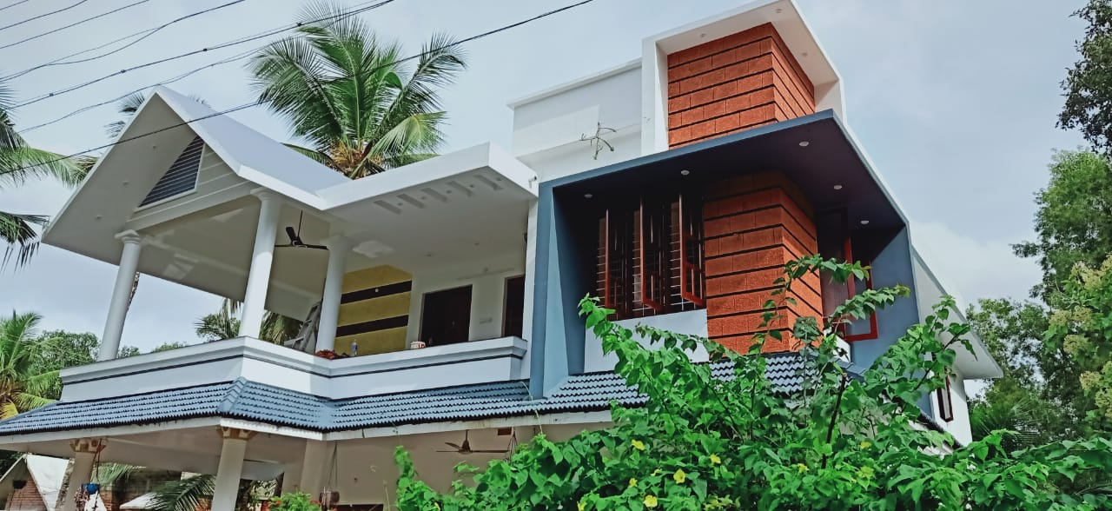
RUFF N TUFF DECORA DHOLPUR SITE AT MANAPALLY DONE BY MR. SIVAKUMAR

Slide 20
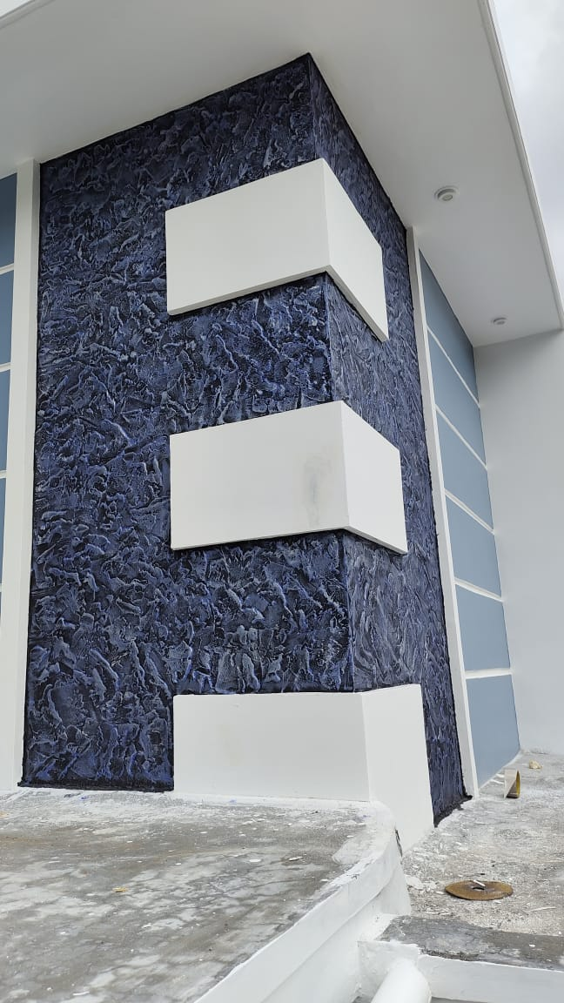
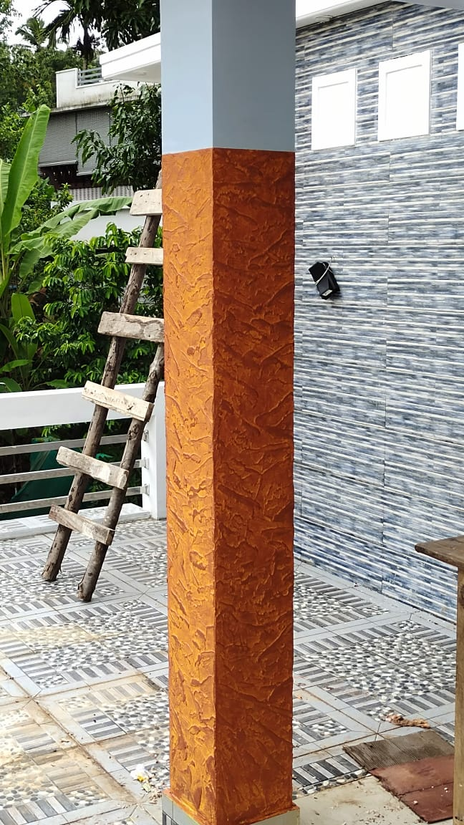
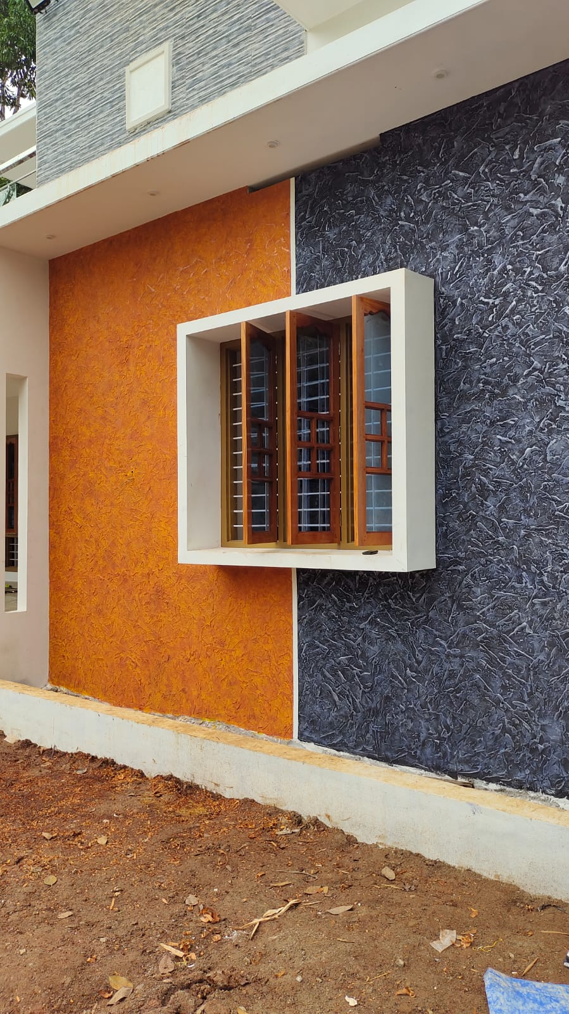
RUFF N TUFF DECORA DHOLPUR SITE AT CHADAYAMANGALAM DONE BY MR. MANU (HI-TECH)

Slide 21
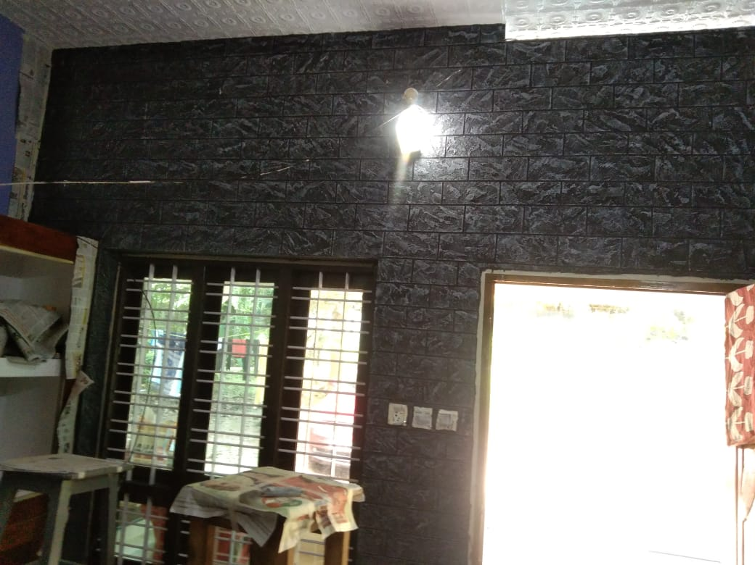
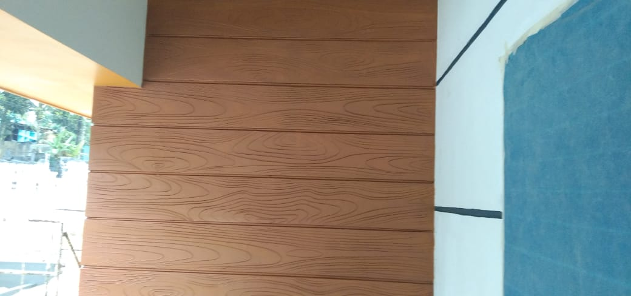
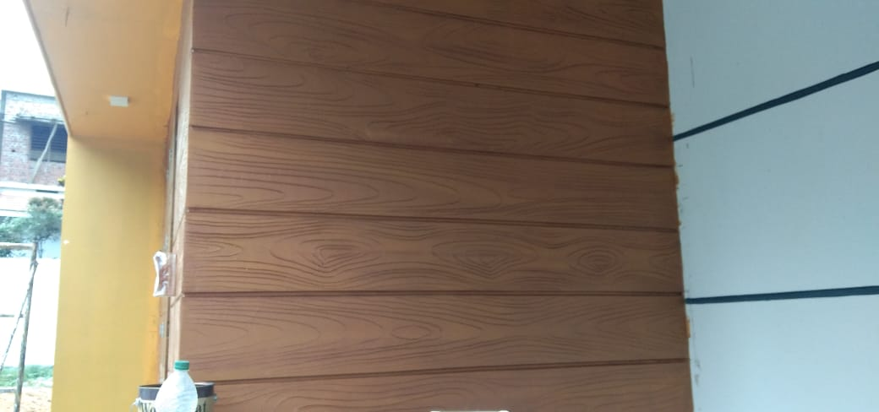
RUFF N TUFF DECORA DHOLPUR SITE AT KOTTARAKKARA AND CHATHANOOR DONE BY MR. BIJU

Slide 22
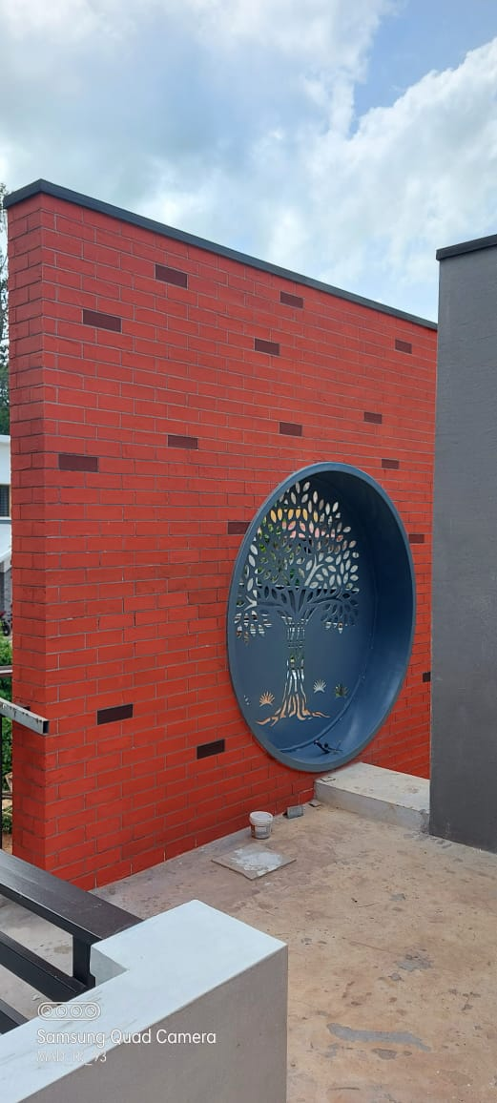
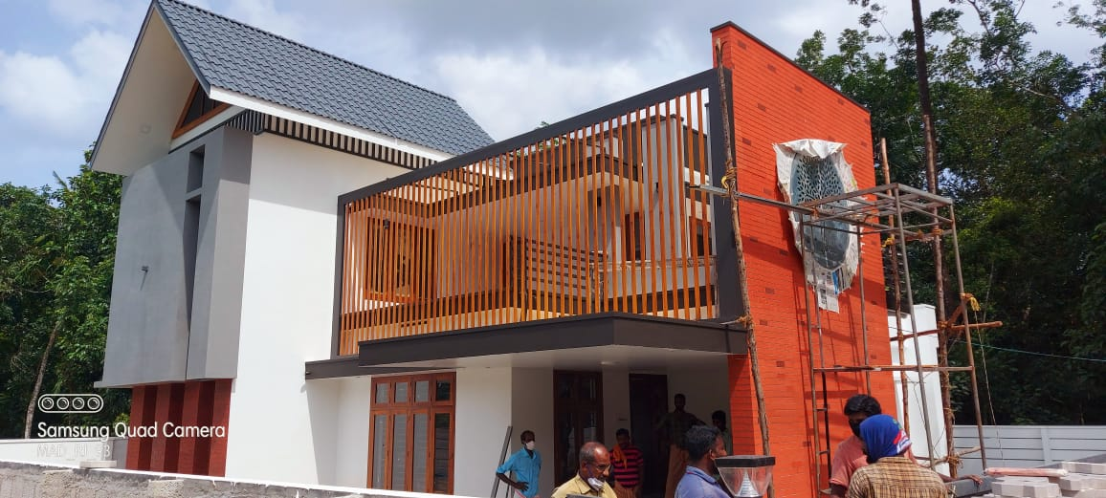
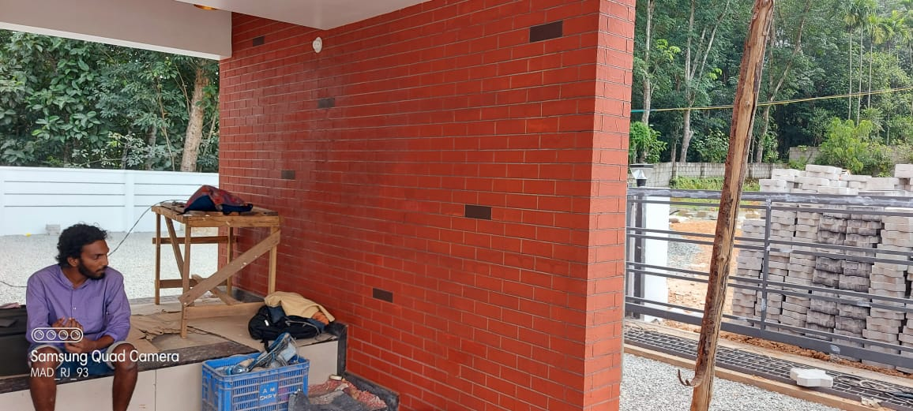
RUFF N TUFF DECORA DHOLPUR SITE AT ADOOR DONE BY MR. ROBERT

Slide 23
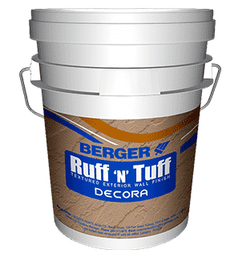
BERGER
RUFF N TUFF
DECORA ROLLERCOAT
Durable Spike textured finish
Special synthetic copolymer emulsion reinforced with quartz & marble powder offering spike like texture
Excellent durability, long lasting
Covers surface imperfections & roughness Green Pro Certified

Slide 24
BERGER
RUFF N TUFF
DECORA ROLLERCOAT
Solvent Dilution ratio Coverage Drying Time Finish/Shades Pack size
Application tools
Shelf life / Potlife
Potable Water
~ 5 % (v/v) water for better workability
4 ~ 6 Sqft / kg / coat
Surface dry – 30 mins
Hard Dry: 12 ~ 16 hours
Matt / Off -White
30 KG drum/bag
Honey comb roller
12 months in drum packing; 6 month in bag / 2 -3 hrs of thinned material

Slide 25
RUFF N TUFF
DECORA ROLLERCOAT
PRODUCT | DILUTION | COVERAGE | TOOLS | MATERIAL COST
ROLLER COAT | 3-5% of fresh water | 4-6 Sq.ft./Kg/Coat | HONEY COMB ROLLER | 7.6/Sq.ft

Slide 26
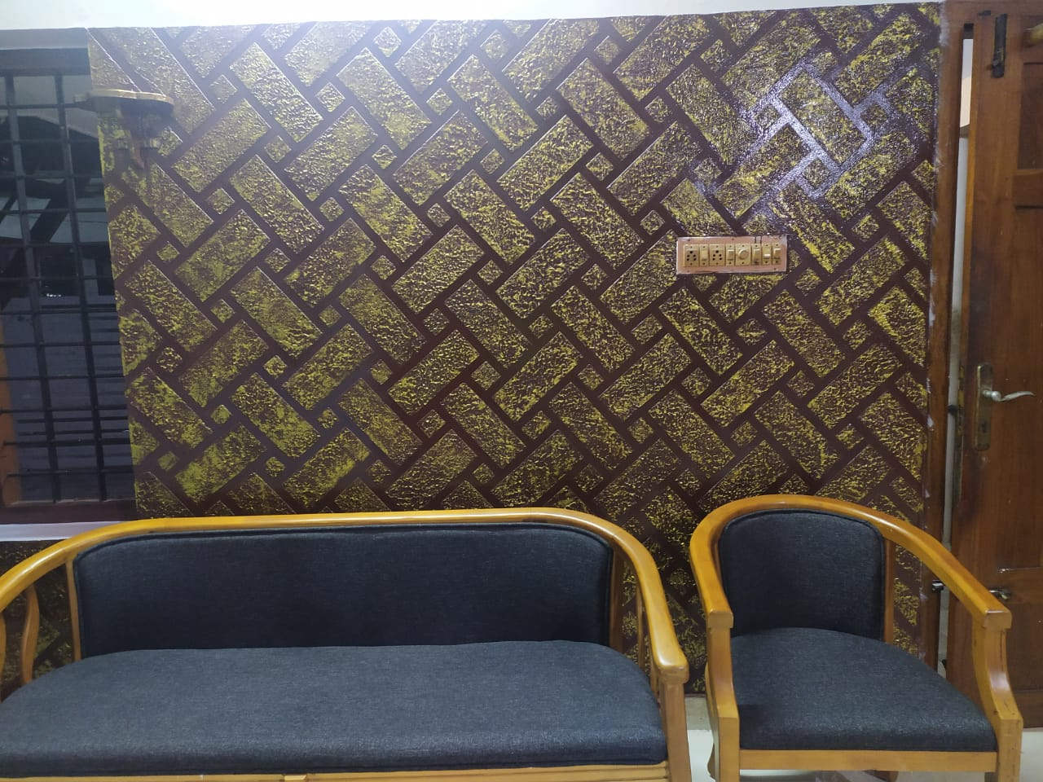
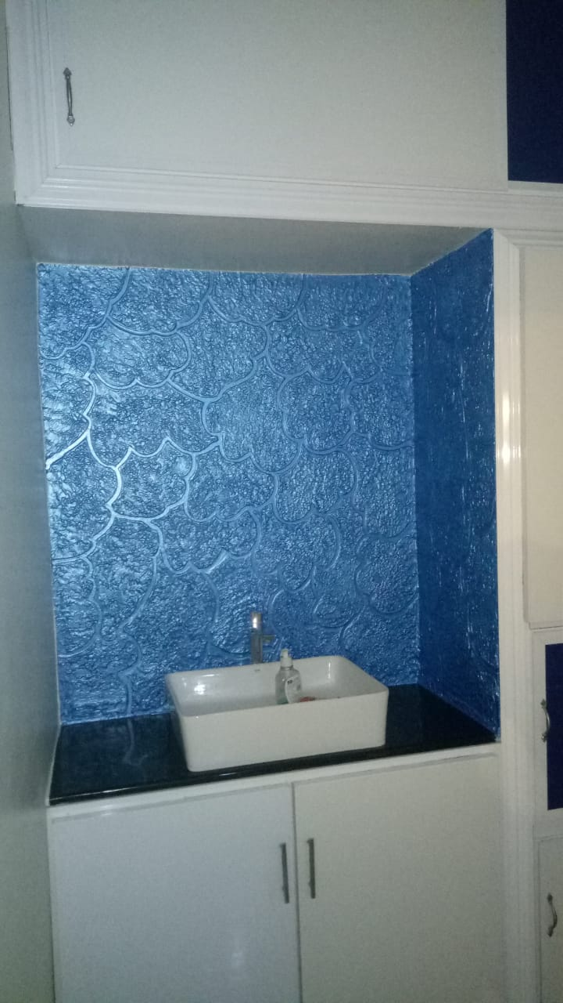
RUFF N TUFF DECORA ROLLERCOAT SITE AT KOLLAM DONE BY MR. VIPIN

Slide 27

BERGER
RUFF N TUFF
DECORA ROLLERCAST
Assorted textured finish
Reinforced with quartz & aggregates Excellent durability, long lasting
Covers surface imperfections & roughness Green Pro Certified

Slide 28
BERGER
RUFF N TUFF
DECORA ROLLERCAST
Solvent Dilution ratio Coverage Drying Time Finish/Shades Pack size
Application tools
Shelf life / Potlife
Potable Water
~ 5 % (v/v) water for better workability
6 ~ 8 Sqft / kg / coat
Surface dry – 30 mins
Hard Dry: 12 ~ 16 hours
Matt / Off -White
30 KG drum/bag
Honey comb roller
12 months in drum packing; 6 month in bag / 2 -3 hrs of thinned material

Slide 29
RUFF N TUFF
DECORA ROLLERCAST
PRODUCT | DILUTION | COVERAGE | TOOLS | MATERIAL COST
ROLLERCAST | 3-5% of fresh water | 6-8 Sq.ft./Kg/Coat | HONEYCOMB ROLLER | 7.5/Sq.ft

Slide 30
BERGER
RUFF N TUFF
DECORA PLAINO SUPERCAST
Assorted textured finish
Reinforced with quartz & aggregates Excellent durability, long lasting
Covers surface imperfections & roughness Green Pro Certified

Slide 31
BERGER
RUFF N TUFF
DECORA PLAINO SUPERCAST
Solvent Dilution ratio Coverage Drying Time Finish/Shades Pack size
Application tools
Shelf life / Potlife
Potable Water
~ 5 % (v/v) water for better workability
2.5 ~ 3.5 Sqft / kg / coat
Surface dry – 30 mins
Hard Dry: 12 ~ 16 hours
Matt / Off -White
30 KG drum/bag
Honey comb roller
12 months in drum packing; 6 month in bag / 2 -3 hrs of thinned material

Slide 32
RUFF N TUFF
DECORA PLAINO SUPERCAST
PRODUCT | DILUTION | COVERAGE | TOOLS | MATERIAL COST
PLAINO SUPERCAST | 3-5% of fresh water | 2-3.5 Sq.ft./Kg/Coat | HONEYCOMB ROLLER | 16/Sq.ft

Slide 33
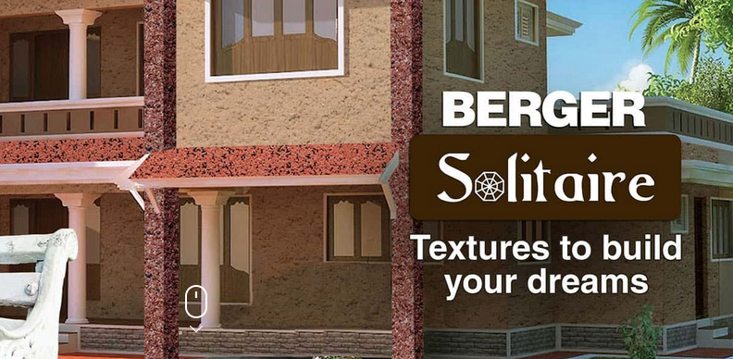



Slide 34
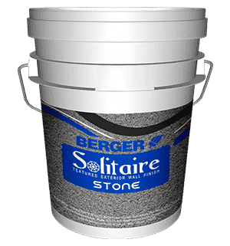
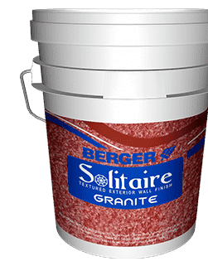



SOLITAIRE STONE / GRANITE
Natural stone & Granite like finish
Formulated with pure acrylic emulsion with natural, colored aggregates & quartz
All weather durability & resistant to mechanical damage
Possible to get single and multi color combinations Both for Interior & Exterior;
Green Pro Certified

Slide 35
SOLITAIRE STONE / GRANITE
Solvent Dilution ratio Coverage Drying Time Finish/Shades Pack size
Application tools
Shelf life / Potlife
Potable Water
Upto 5% (v/v) water for better workability
2 – 2.5 Sqft / kg / 2 coats
Surface dry - 30 minutes
Hard Dry: 16- 18 hours
Matt / Natural Stone like color
30 KG
Trowel / Texture spray gun
12 months in drum packing / 2 -3 hrs of thinned material

Slide 36

SOLITAIRE STONE / GRANITE
(APPLICATION SYSTEM)
Direction of use
Primer application – apply 1 coat of WC exterior primer/Seal-o-prime and allow it for 4-6hrs
Joint Sealer application – to get a tile like pattern with grooves, apply 1 coat as per required shade. After 8 hrs, fix masking
tape as per the preferred size of the grooves.
Texture application – Apply smooth & uniform 1st coat of Solitaire Stone / Granite base coat by trowel & remove masking tape. Allow the base coat to dry for 16-18 hrs. Re-fix the masking tape and apply 2nd coat of of Solitaire S/G as pattern coat by hopper spray gun to get desired texture pattern. Remove masking tape in wet condition and allow it to dry for 16-18 hrs.
Clear coat – Apply 2 coats of Solitaire Acrylic Clear- Matt/Gloss (clear lacquer) with recommended dilution as finishing coat to increase longevity and avoid dust deposition.

Slide 37






SOLITAIRE SITE AT ADOOR & THEVALAKKARA DONE BY MR. VIPIN

Slide 38


SOLITAIRE SITE AT ADOOR DONE BY MR. LALU

Slide 39



FLORENTINA

Slide 40




Slide 41






FLORENTINA GLITTERATTI
Single & Multi –colored luxury texture with Glitter effect In 12 attractive unique shades
Combination of selected aggregate including Mica & a high quality acrylic binder
Tough & ever lasting – resist algal & fungal growth
Weather proof – suitable for adverse conditions UV resistance
Both for Interior & Exterior; Green Pro Certified

Slide 42
FLORENTINA GLITTERATTI (TECHNICAL SPECIFICATIONS)
Solvent Dilution ratio Coverage Drying Time Finish/Shades Pack size
Application tools
Shelf life
Potable Water
Upto 5% (v/v) water for better workability
2.5 to 3 Sqft / kg / 2 coats
Surface dry - 30 minutes
Hard Dry: 16 – 18 hours
Textured & Glittering / 12 Shades
PART A – 10 kg & PART B – 20 Kg
Acrylic trowel/ Steel trowel
24 months in drum packing

Slide 43
FLORENTINA GLITTERATI
(PRODUCT PREPARATION & APPLICATION SYSTEM)
The product consists of 2 components
Part A (10 kg) – specially formulated medium
Part B (20 kg) – Natural aggregates of different colored stones and mica flakes
Preparation method
1. Pour Part A into the empty container
2. slowly add Part B into Part A
3. Mix contents thoroughly to a uniform consistency with mechanical stirrer
Recommended DFT: 1.5 – 2 mm
Direction of use
Primer application – apply 1 coat of WC exterior primer/Seal-o-prime and allow it for 4-6hrs
Joint Sealer application – to get a tile like pattern with grooves, apply 1 coat as per required shade. After 8 hrs, fix masking tape as
per the preferred size of the grooves.
Texture application – Apply smooth & uniform 1st coat of Florentina Glitteratti (FG) by trowel & remove masking tape. Allow to dry for 12-16 hrs. Re fix the masking tape and apply 2nd coat of FG as topcoat to get desired finish. Remove masking tape in wet condition and allow it to dry overnight.
Clear coat – Apply 1 or 2 coats of Solitaire Acrylic Clear-Gloss with recommended dilution as finishing coat to increase longevity and avoid dust deposition.

Slide 44



FLORENTINA GLITTERATI TEXTURE
Dark side
Deep treasure
Electric wine

Slide 45



FLORENTINA GLITTERATI TEXTURE
Elegant grey
White duck
Milk lake

Slide 46




Slide 47




FLORENTINA SANDSTONE
High build pure acrylic resin texture body coat
incorporating natural granite chip with pearl effect.
In 12 attractive unique shades
Tough & ever lasting – resist algal & fungal growth Weather proof – Silicon additives for enhanced water repellence;
UV resistance
Both for Interior & Exterior; Green Pro Certified

Slide 48
FLORENTINA SANDSTONE (TECHNICAL SPECIFICATIONS)
Solvent Dilution ratio Coverage Drying Time Finish/Shades Pack size
Application tools
Shelf life
Potable Water
Upto 5% (v/v) water for better workability
2.5 to 3 Sqft / kg / 2 coats
Surface dry - 30 minutes
Hard Dry: 16 – 18 hours
Granite chip with pearl effect / 12 Shades
PART A – 10 kg & PART B – 20 Kg
Acrylic trowel/ Steel trowel & Paint brush for design
24 months in drum packing

Slide 49
FLORENTINA SANDSTONE
(PRODUCT PREPARATION & APPLICATION SYSTEM)
The product consists of 2 components
Part A (10 kg) – specially formulated medium
Part B (20 kg) – Natural aggregates of different colored stones
Preparation method
1. Pour Part A into the empty container
2. slowly add Part B into Part A
3. Mix contents thoroughly to a uniform consistency with mechanical stirrer
Recommended DFT: 1.5 – 2 mm
Direction of use
Primer application – apply 1 coat of WC exterior primer/Seal-o-prime and allow it for 4-6hrs
Joint Sealer application – to get a tile like pattern with grooves, apply 1 coat as per required shade. After 8 hrs, fix masking tape as
per the preferred size of the grooves.
Texture application – Apply smooth & uniform 1st coat of Florentina Sandstone (FS) by trowel & remove masking tape. Allow to dry for 12-16 hrs. Re fix the masking tape and apply 2nd coat of FS as topcoat to get desired finish. Remove masking tape in wet condition and allow it to dry overnight.
Clear coat – Apply 1 or 2 coats of Solitaire Acrylic Clear-Gloss with recommended dilution as finishing coat to increase longevity and avoid dust deposition.

Slide 50





FLORENTINA SANDSTONE TEXTURE

Slide 51




Slide 52



FLORENTINA VINTAGE
Creates elegant finishes of trendy natural and concrete designs
Formulated with pure acrylic emulsion with silicon Available in 9 artistic designs
Tough & ever lasting – resist algal & fungal growth Weather proof – Silicon additives for enhanced water repellence;
UV resistance
Both for Interior & Exterior; Green Pro Certified

Slide 53
FLORENTINA VINTAGE (TECHNICAL SPECIFICATIONS)
Solvent Dilution ratio Coverage Drying Time Finish/Shades Pack size
Application tools
Shelf life / Potlife
Potable Water
Upto 5% (v/v) water for better workability
3 to 5 Sqft / kg / 2 coats
Surface dry - 45 minutes
Hard Dry: 8 - 12 hours
9 artistic designs / White shade
30 KG
Roller/Brush /Trowel
12 months in drum packing / 12 hrs of thinned material

Slide 54
FLORENTINA VINTAGE
(APPLICATION SYSTEM)
Recommended DFT: 0.8 – 1.5 mm
Direction of use
Primer application – apply 1 coat of WC exterior primer/Seal-o-prime and allow it for 4-6hrs Texture application –
Step 1 : Base coat – apply smooth & uniform 1st coat of Florentina Vintage- by trowel & allow it to dry for 6 -8 hrs.
Step 2 : Pattern creation coat – apply 2nd coat of FV- by trowel & use apecific design tools immediately to make design pattern
Step 3: Clear coat application – Apply 1st coat water repellent Solitaire acrylic clear- Matt with recommended dilution- by roller/brush and allow it to dry for 6 – 8 hrs
Step 4: Tinted clear coat application- Tint Solitaire Acrylic clear- Matt with specific colorants to get the desired shade. Apply it with roller. Wipe off with sponge block in the direction of the prepared pattern to get the desired finish.

Slide 55






FLORENTINA SANDSTONE TEXTURE

Slide 56
Thank you.

